Slide 1
Midterm presentation
ECE387
Mingshuai Song

Slide 2
Introduction
Chip — Ultrasonic range sensor
What is it?
How does it work?
Application
Simply demo
Notes:
The chip I choose is Ultrasonic(aotro) range sensor
In this presentation, I will mainly introduce what is it, how does it work, and its applications. At last, I will show a very simply demo.

Slide 3
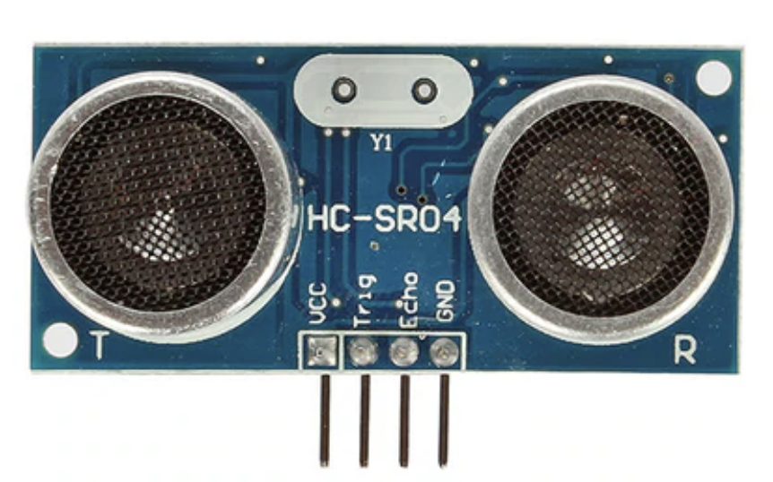
Ultrasonic range sensor
HC-SR04
Measure distance
Notes:
As the name indicates, ultrasonic range sensor measures distance by using ultrasonic waves.

Slide 4
Datasheet
Unit Price : $5.9500
Operating Voltage: 5V
Working Current: 15 mA
Distance Range: 2cm to 400cm
100% Arduino Compatible
Notes:
And this is the datasheet of the sensor
It is pretty interesting since it only has few lines
The unit price is low
And it can measure the distance from 2 centimeters to 4 meters
It is fully compatible(compaitebao) with Arduino

Slide 5
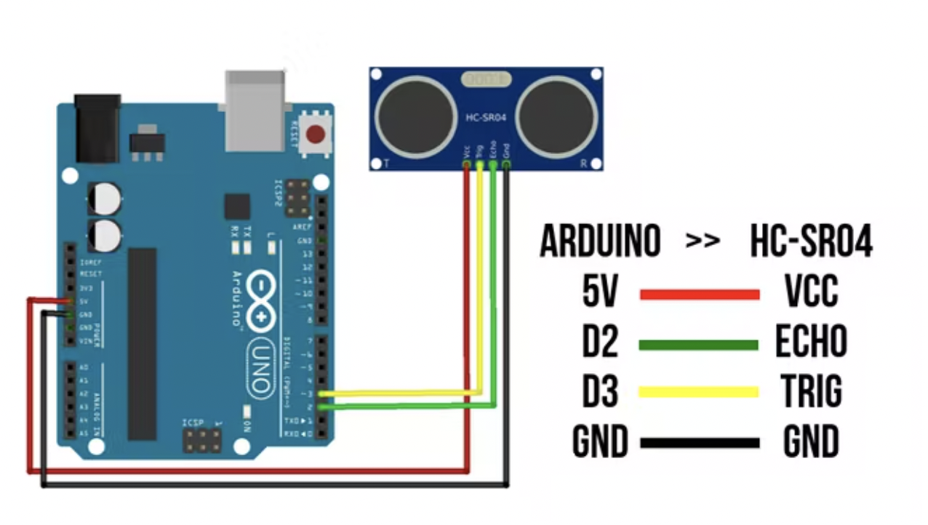
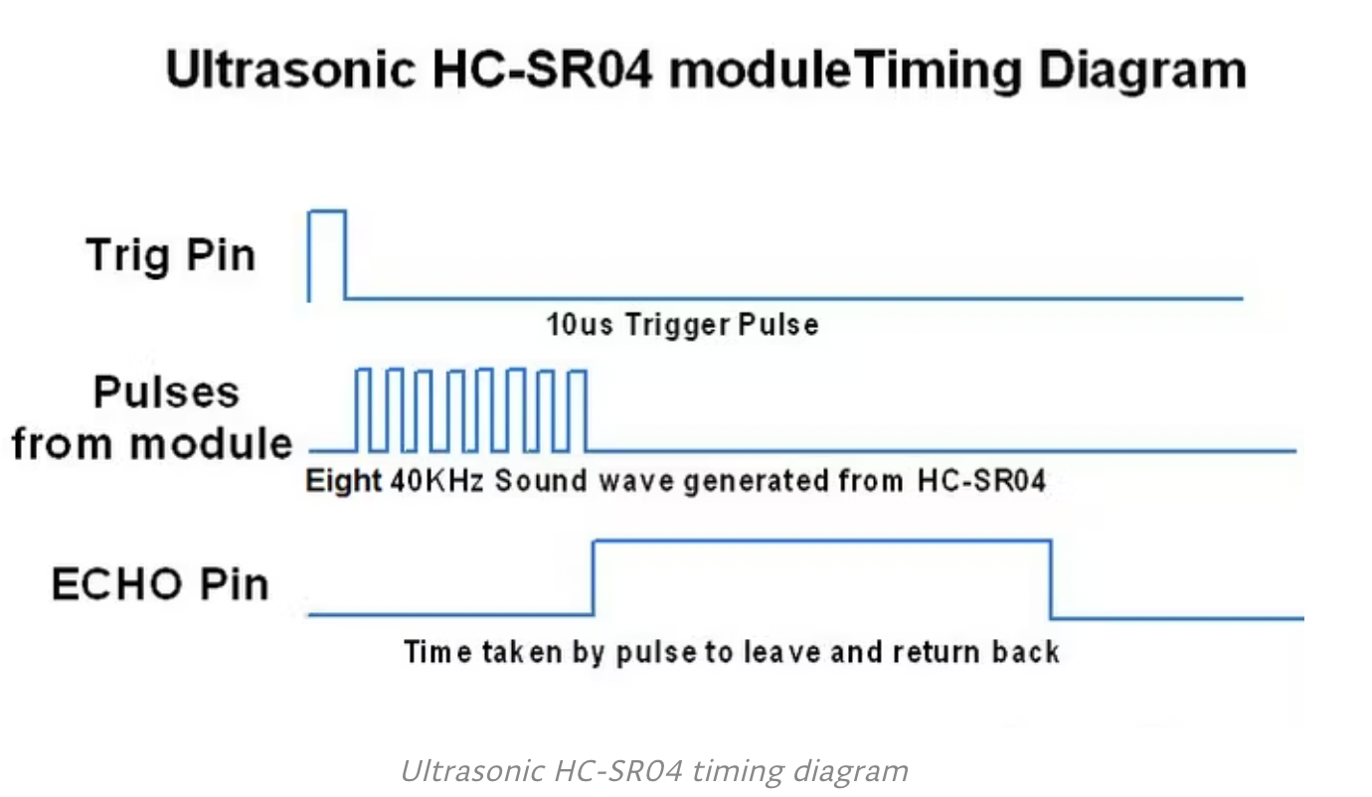
How to Connect with Arduino
Notes:
About how to connect this sensor to the Arduino
From left to the right, the first connects the power, the second one is the Trigger Pin(pen). we will connect to pin 3. In order to generate the ultrasound, we need to set the Trigger Pin on a High State for 10 microseconds. Then it will send out an 8 cycle sonic burst which will travel at the sound speed and it will be received in the Echo(aikao) Pin which connect to pin2. The Echo Pin will output the time of the traveled wave. And the last wire(waier) will connect to the ground.

Slide 6
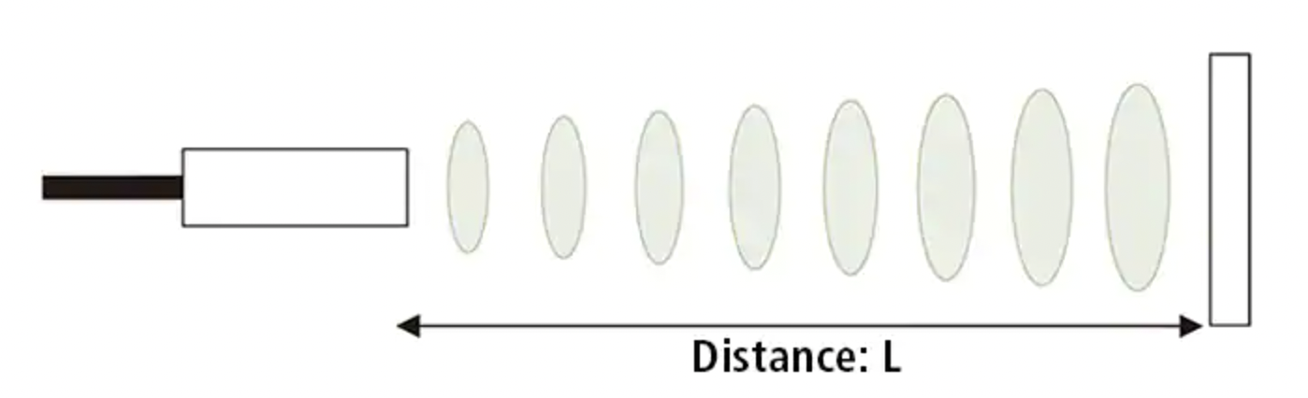
How does it work?
Formula: L = 340m / s * t / 2
Notes:
HOW DOES IT WORK
The ultrasonic transmitter emits(emei) waves in a certain direction, and we start timing at the same time. When the wave in the air encounters(in) an object, it returns immediately, the ultrasonic receiver receives the reflected wave, and then we stop the timing. The sound speed in the air is 340 meters per second, and according to the recorded time, we can calculate the distance between the sensor and the object, thus realizing ultrasonic ranging.

Slide 7
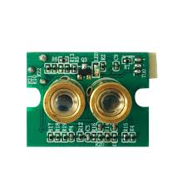
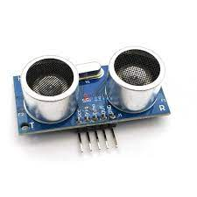
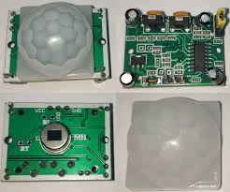
Distance sensors
Notes:
When it comes to distance sensors, there are many different types, like ultrasonic range, infrared(infered) range, and laser distance.
But different sensors have different features. For example, infrared(infered) range is small in size and very good at measuring objects with complex surfaces. Laser distance has a high measurement range and is good at measuring high-speed moving, small and 3D objects. The ultrasonic sensor is the most common distance sensor. It is not affected by object color. It works well in the dark and tends to draw lower current. And it has multiple interface options for pairing with a microcontroller. However, the detection range of ultrasonic sensors is limited. Due to its low resolution and refresh rate, it is not suitable for detecting fast moving objects. and it also cannot measure distances when objects has complex textures.

Slide 8
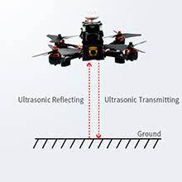
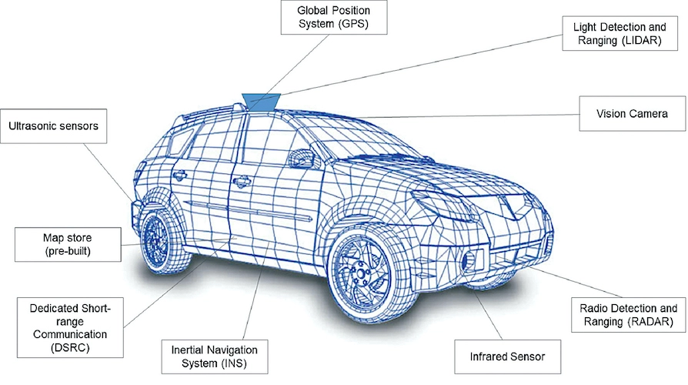
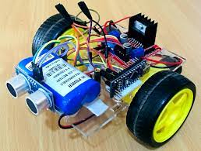
Application
Notes:
The application of ultrasonic range sensor is very extensive, it performs well on the detection range, solution cost, and reliability across different surfaces. We can use it for daily distance measurement, and making robots.
The drone(zhon) can be maintained at a constant height and land safely by ultrasonic range sensors
And even Tesla(taisla) using 12 ultrasonic range sensors as part of its self-driving program to help detect roads and other vehicles(vekaos) in parking areas.

Slide 9

Demo
Notes:
I prepared a very simply demo by using Ultrasonic range sensor and three LEDs.
If the distance between the object and sensor is less than 20cm, the green LED will be on, if it is less than 10, the yellow LED will also be on, if it is less than 5, three LEDs will light up at the same time

Slide 10
Citation
ago, Shawn 2 years, et al. “Types of Distance Sensors and How to Select One?” Latest Open Tech From Seeed, 29 June 2021, https://www.seeedstudio.com/blog/2019/12/23/distance-sensors-types-and-selection-guide/.
“Detection Based on ‘Ultrasonic Waves‘What Is an Ultrasonic Sensor?” KEYENCE, https://www.keyence.com/ss/products/sensor/sensorbasics/ultrasonic/info/#:~:text=As%20the%20name%20indicates%2C%20ultrasonic,between%20the%20emission%20and%20reception.
Arduino - Ultrasonic Sensor, https://www.tutorialspoint.com/arduino/arduino_ultrasonic_sensor.htm.
“Ultrasonic Sensor HC-SR04 with Arduino Tutorial.” Arduino Project Hub, https://create.arduino.cc/projecthub/abdularbi17/ultrasonic-sensor-hc-sr04-with-arduino-tutorial-327ff6.
Rathore, Abhimanyu. “Autopilot Applications for Autonomous Vehicles.” Electronics For You, 5 Aug. 2021, https://www.electronicsforu.com/market-verticals/autopilot-applications-autonomous-vehicles.
“Where Are Ultrasonic Sensors Used? – Part 2.” Analog - Technical Articles - TI E2E Support Forums, https://e2e.ti.com/blogs_/b/analogwire/posts/where-are-ultrasonic-sensors-used-part-2.

Slide 11

Thanks

